Slide 1
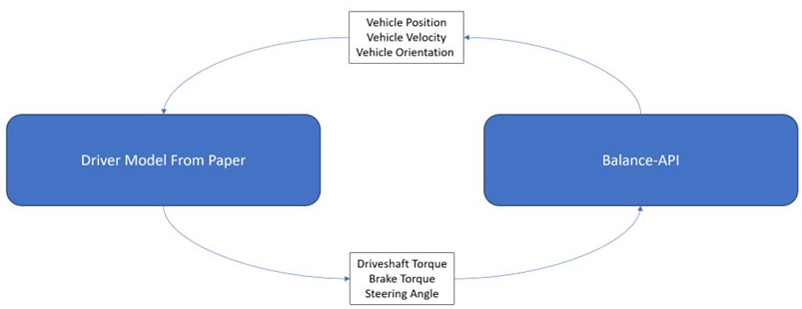
Recap
2
1

Slide 2
Benchmark Mathematical Model <=> Balance Integration
Benchmark Mathematical Driver Model
Balance Integration
Path Following – Steer Control
Reference Trajectory
Balance Output [State Variables (Position, Velocity, Yaw Rate)]
Torque Model – Speed Control
Target Velocity
Balance Input [Steering Angle, Driveshaft Torque, Brake Torque]
Trajectory Plots
Trajectory and Value Plots

Slide 3
AI/ML Model <=> Balance Integration
AI/ML Driver Model
Balance Integration
Balance Output [State Variables (Position, Velocity, Yaw Rate)]
Train Model
Car Dynamics
DQN Agent
Balance Input [Steering Angle, Driveshaft Torque, Brake Torque]
Trajectory Plots
Trajectory and Value Plots

Slide 4
Scenario 1 - AI/ML Model <=> Balance Integration - Quick test and fail
AI/ML Driver Model
Benchmark Mathematical Driver Model
Balance Integration
Steer Control
Reference Trajectory
Balance Output [State Variables (Position, Velocity, Yaw Rate)]
Train Model
Car Dynamics
Speed Control
Target Velocity
DQN Agent
Balance Input [Steering Angle, Driveshaft Torque, Brake Torque]
Trajectory Plots
Trajectory and Value Plots

Slide 5
Scenario 1 - AI/ML Model <=> Balance Integration - Quick test and fail
Car Dynamics
Velocity
np.sqrt( np.square(self.car.hull.linearVelocity[0])
+ np.square(self.car.hull.linearVelocity[1])
)
Position
car_position_x = self.car.hull.position.x
car_position_y = self.car.hull.position.y
Yaw Angle
self.car.hull.angle
Benchmark Mathematical Driver Model
Balance Integration
Steer Control
Reference Trajectory
Balance Output [State Variables (Position, Velocity, Yaw Rate)]
Speed Control
Target Velocity
Balance Input [Steering Angle, Driveshaft Torque, Brake Torque]
Trajectory Plots
Trajectory and Value Plots

Slide 6
Scenario 2 - AI/ML Model <=> Balance Integration - If Nothing works then we go with this route
AI/ML Driver Model
Balance Integration
Balance Output [State Variables (Position, Velocity, Yaw Rate)]
Train Model
Car Dynamics
Steer Control
Reference Trajectory
DQN Agent
Speed Control
Target Velocity
Balance Input [Steering Angle, Driveshaft Torque, Brake Torque]
Trajectory Plots
Trajectory and Value Plots

